Slide 1
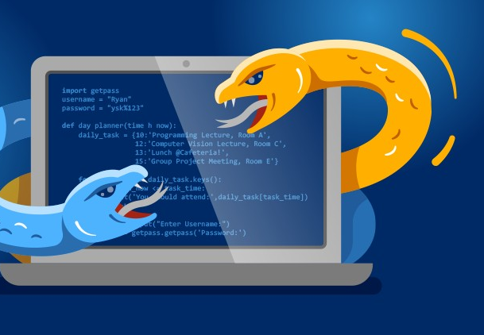

Python Expert
By Yilmaz Mustafa

Slide 2
Emails with Python

Slide 3
In this section we will explore how to send emails with Python and how to check our inbox for received messages.
Please keep in mind this process is highly reliant on admin privileges on both your local computer, your internet, and your email.

Slide 4
It is highly likely that on a corporate network, work computer, or work email these methods will be blocked for security reasons.
If you encounter issues due to this, please contact your IT department, as it is not an issue we can fix on our end.

Slide 5
Lastly, there is no full exercise for these lecture topics, since there is no real way we can create true self-assessments for a personal email address.
However, we do provide a notebook with some ideas for you to explore, we encourage you to get creative!

Slide 6
Let’s get started!

Slide 7
Sending Emails

Slide 8
To send emails with Python, we need to manually go through the steps of connecting to an email server, confirming connection, setting a protocol, logging on, and sending the message.

Slide 9
Fortunately the built-in smtplib library in Python makes these steps simple function calls.

Slide 10
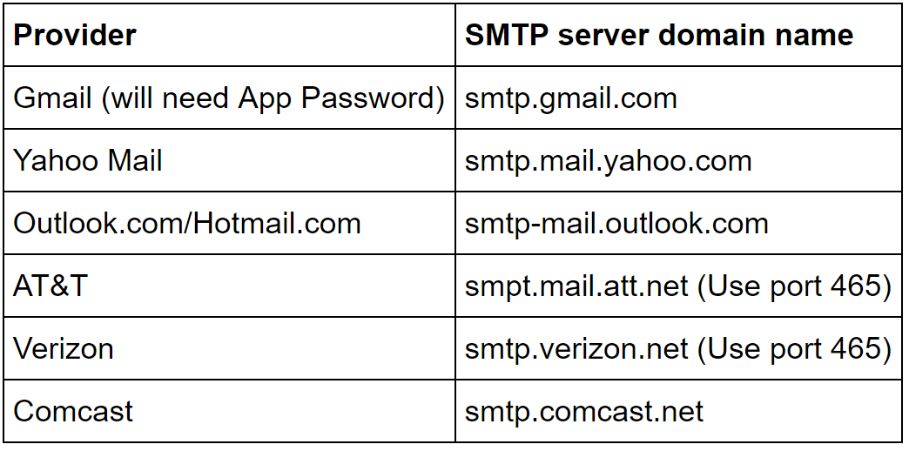
Each major email provider has their own SMTP (Simple Mail Transfer Protocol) Server.

Slide 11
We will go over this process with a Gmail account.
For gmail users, you will need to generate an app password instead of your normal password.
This let’s Gmail know that the Python script attempting to access your account is authorized by you.

Slide 12
Let’s explore this entire process.

Slide 13
Receiving Emails

Slide 14
To view received emails with Python we can use the built in imaplib and email libraries in Python.
The imaplib library has a special syntax for searching your Inbox.

Slide 15
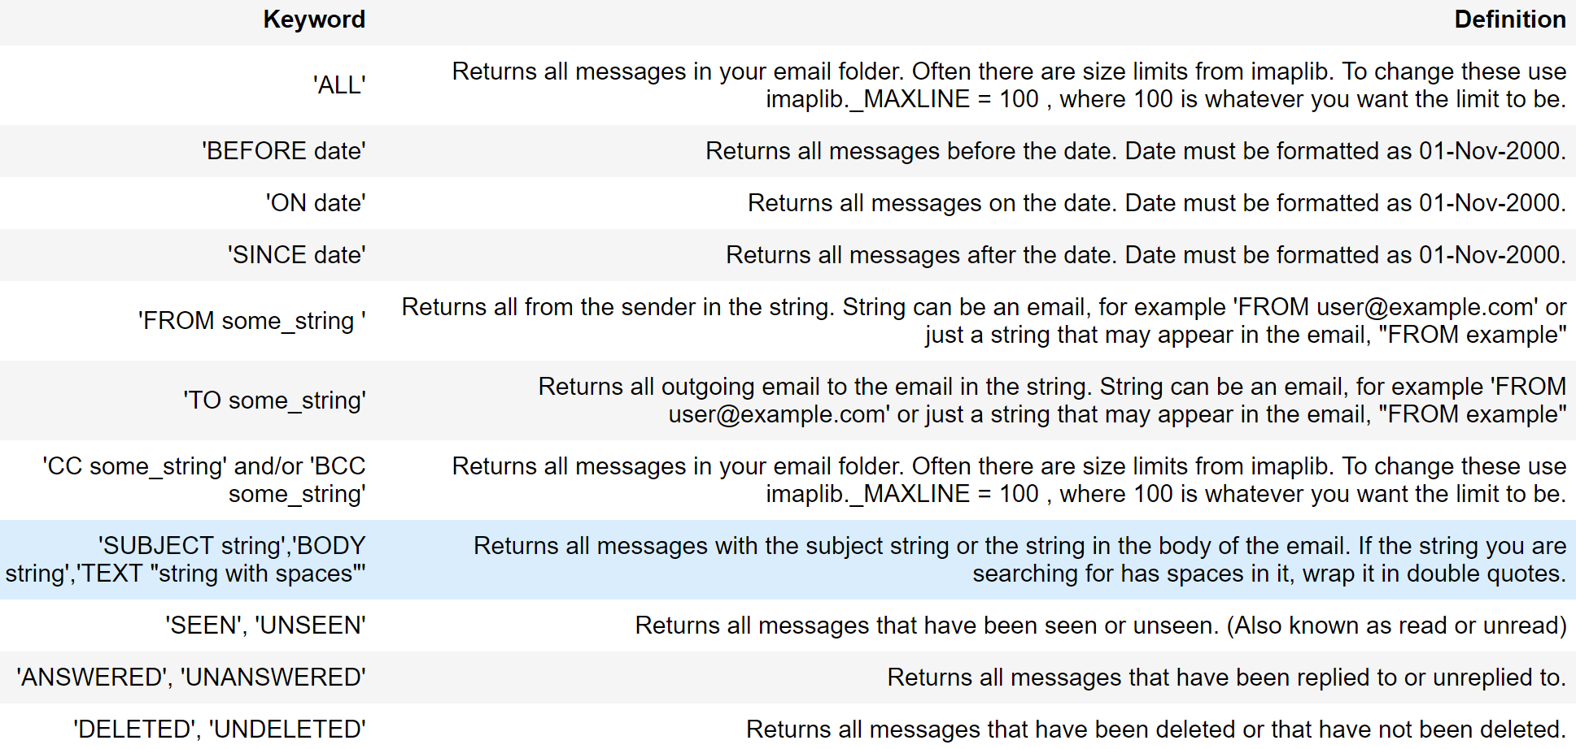

Slide 16
Before beginning this discussion, send yourself a test email with a unique subject line that you will be able to remember and search for using Python.
Let’s begin exploring checking received emails with Python.

Slide 17


